Slide 1


Interpolation
Group-02
P r e s e n t e d b y,
Student ID : 190205182, 190205183, 190205184, 190205185,190205186
Department of Electrical and Electronic Engineering
Ahsanullah University of Science and Technology
Video: https://drive.google.com/file/d/14j2MkCBd8MKgGQL80g5a1ZtxKj_Kssa4

Slide 2
Interpolation
Interpolation
Mathematical
Science
Engineering

Slide 3
Interpolation
Interpolation types
Linear interpolation
Polynomial Interpolation

Slide 4

Interpolation
Linear Interpolation
Theory
f(X_{k}) = Y_{k} ; k=1,2,3,4…n
(X_{a} ,Y_{a}) and (X_{b} , Y_{b})
f(x)=$\frac{x−xb}{xa−xb}ya+\frac{x−xa}{xa−xb}yb$

Slide 5
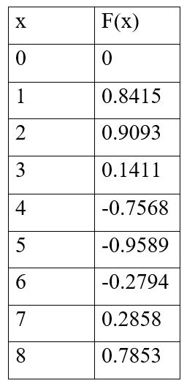
Interpolation
Example

Slide 6
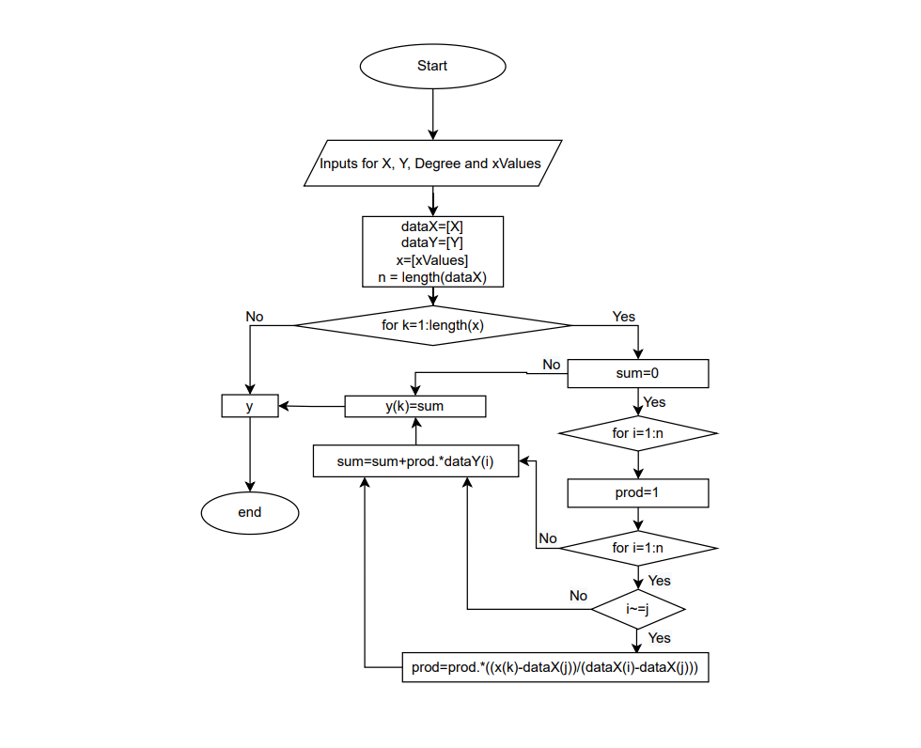
Interpolation
Algorithm

Slide 7


Interpolation
Matlab code for input value
Code view
Design view

Slide 8
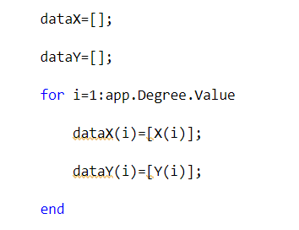

Interpolation
Matlab code for degree value
Code view
Design view

Slide 9
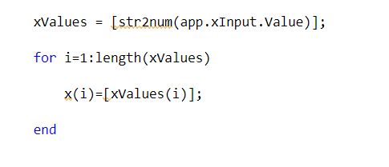

Interpolation
Matlab code for
Code view
Design view

Slide 10
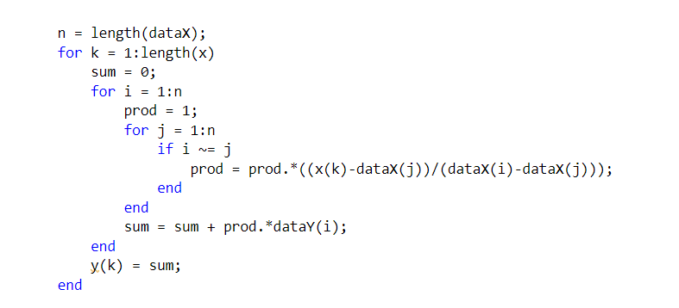
Interpolation
Matlab code for
Main code

Slide 11
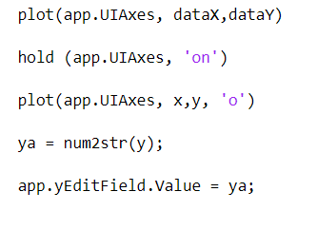

Interpolation
Matlab code for plot
Code view
Design view

Slide 12
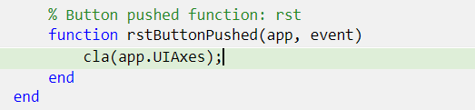

Interpolation
Matlab code for reset
Code view
Design view

Slide 13
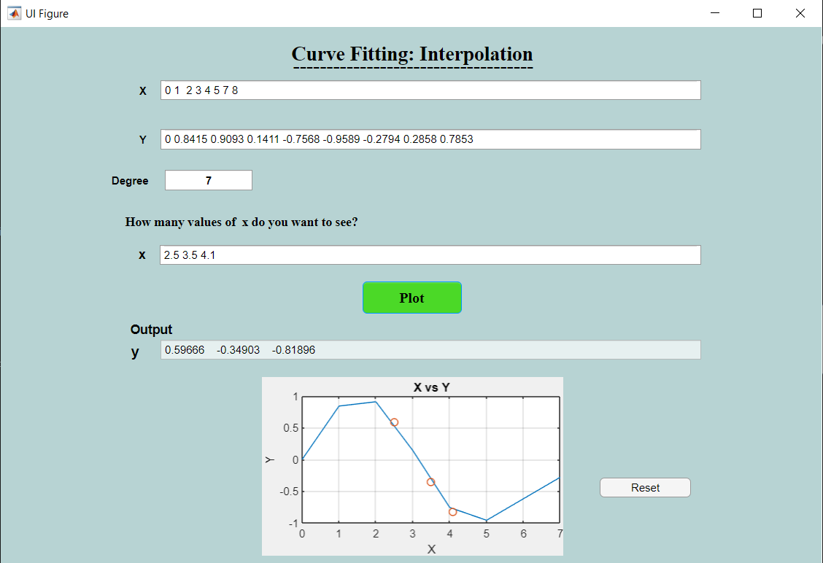
Interpolation
Output value of y

Slide 14
Interpolation
Discussion
Matlab Interpolation
Data Table
Linear & Non-linear
Known & Unknown Point
Mathematical Research
Engineering
Advantage
Disadvantage

Slide 15

Interpolation

